Slide 1
SOLID
The Principles of Object Oriented Design
(https://en.wikipedia.org/wiki/Robert_C._Martin)
Notes:
S.O.L.I.D is an acronym for the first five object-oriented design(OOD)** principles** by Robert C. Martin, popularly known as Uncle Bob.
These principles, when combined together, make it easy for a programmer to develop software that are easy to maintain and extend. They also make it easy for developers to avoid code smells, easily refactor code, and are also a part of the agile or adaptive software development.

Slide 2
Single-responsiblity principle
Open-closed principle
Liskov substitution principle
Interface segregation principle
Dependency Inversion Principle

Slide 3
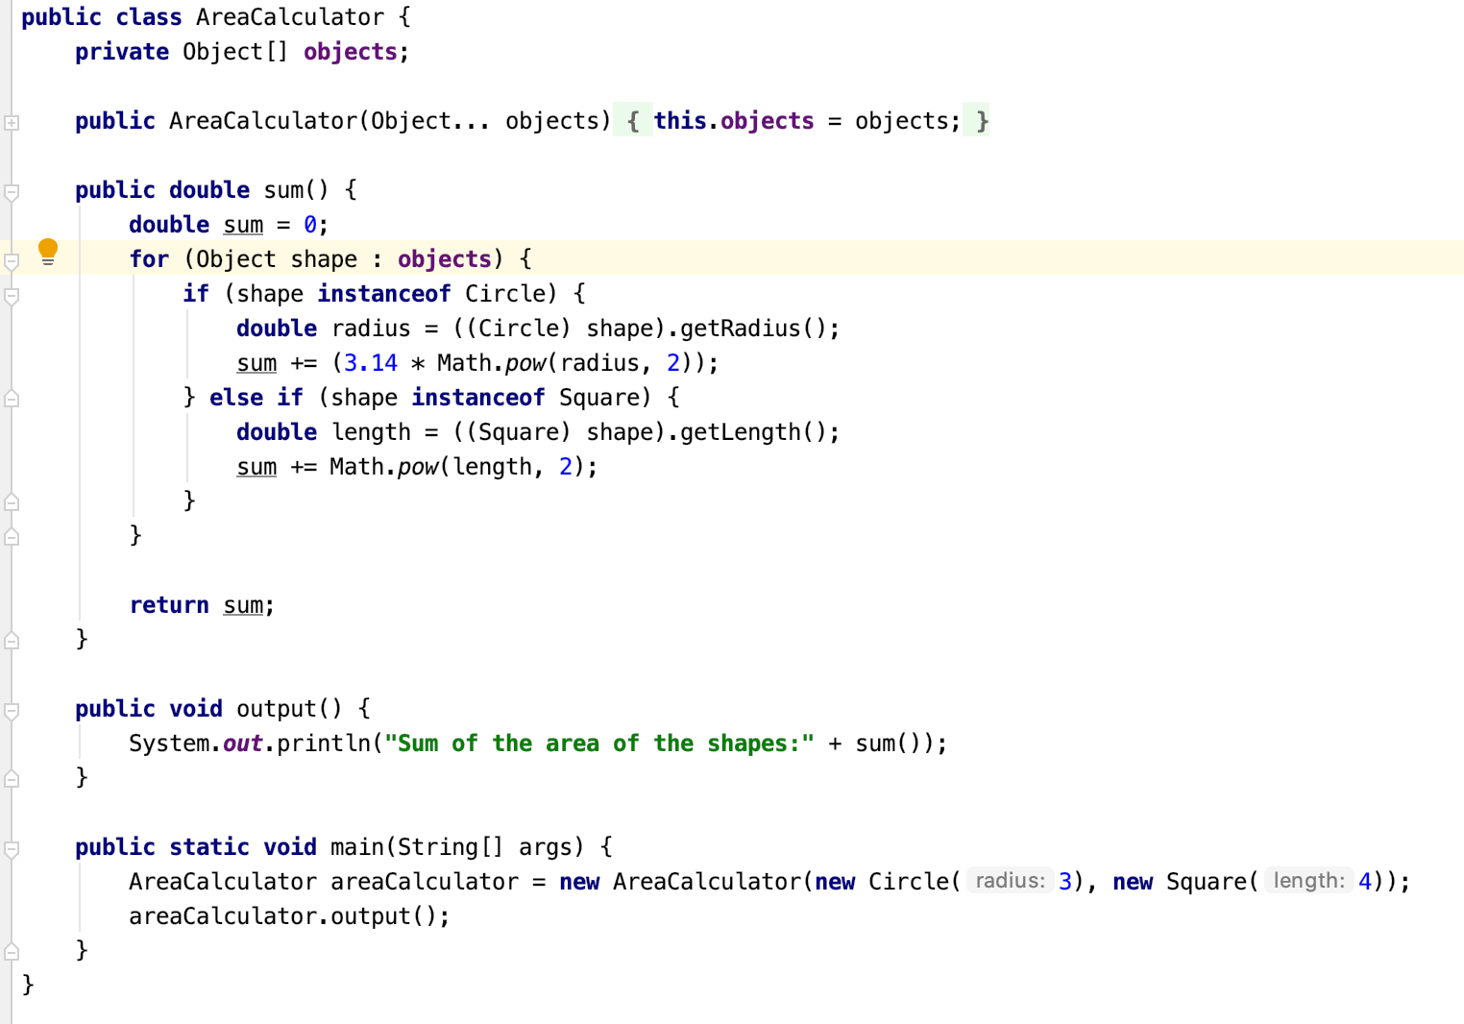
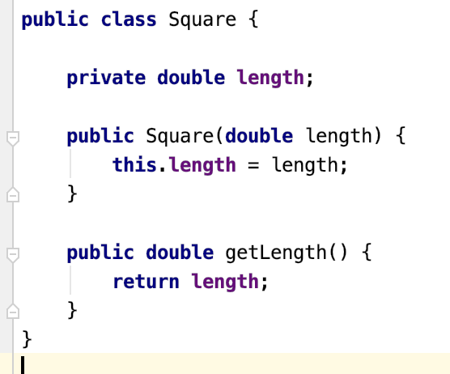
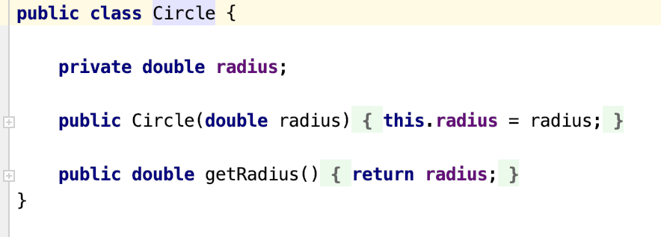
Single-responsibility Principle
A class should have one and only one reason to change, meaning that a class should have only one job.
Notes:
For example, say we have some shapes and we wanted to sum all the areas of the shapes.
AreaCalculator class and then write up our logic to sum up the areas of all provided shapes.
Problems
AreaCalculator handles the logic to output the data. Therefore, what if the user wanted to output the data as json or something else?
Solution
AreaCalculator class should only sum the areas of provided shapes, it should not care whether the user wants json or HTML.

Slide 4
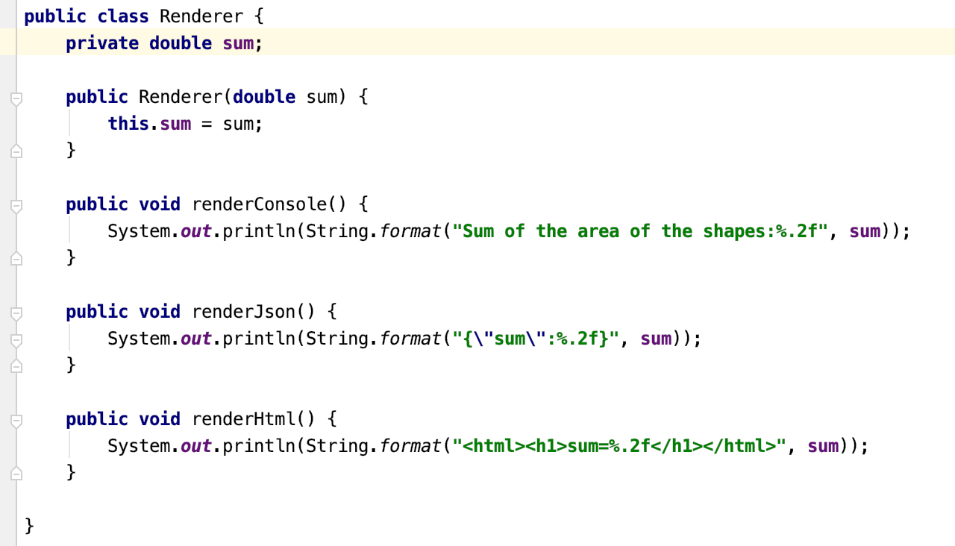
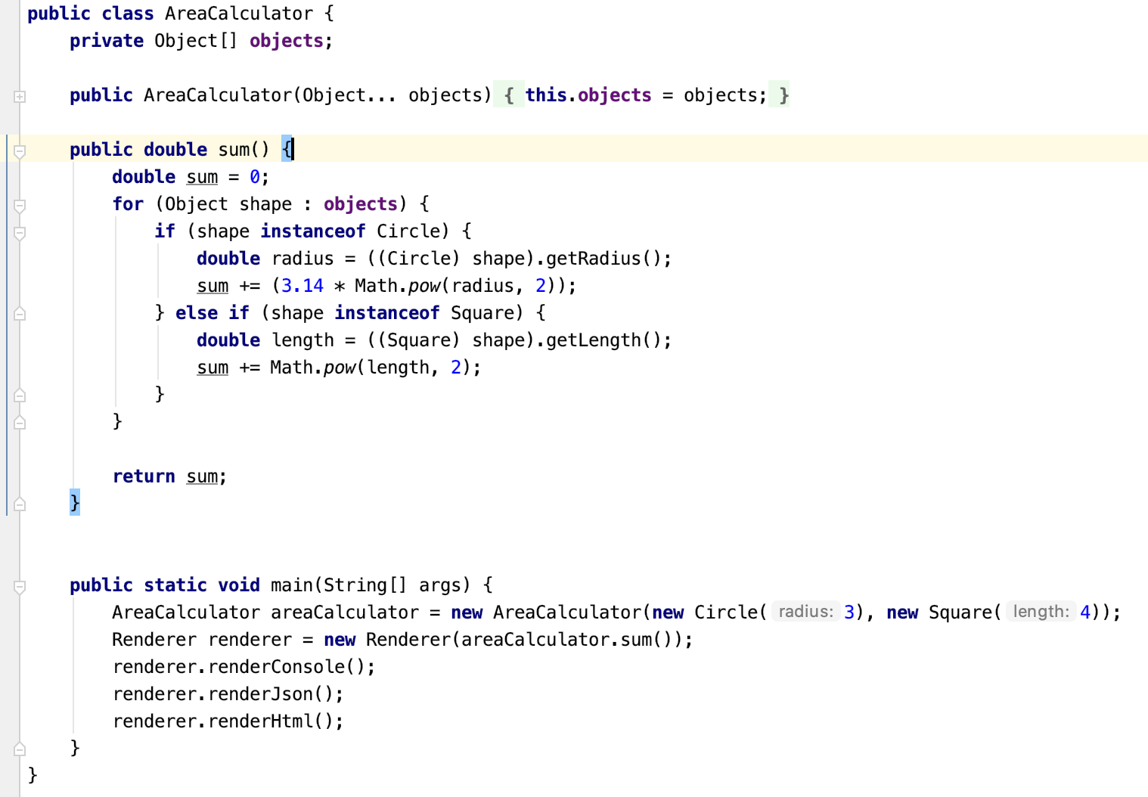
Single-responsibility Principle
Notes:
For example, say we have some shapes and we wanted to sum all the areas of the shapes.
AreaCalculator class and then write up our logic to sum up the areas of all provided shapes.
Problems
AreaCalculator handles the logic to output the data. Therefore, what if the user wanted to output the data as json or something else?
Solution
AreaCalculator class should only sum the areas of provided shapes, it should not care whether the user wants json or HTML.

Slide 5
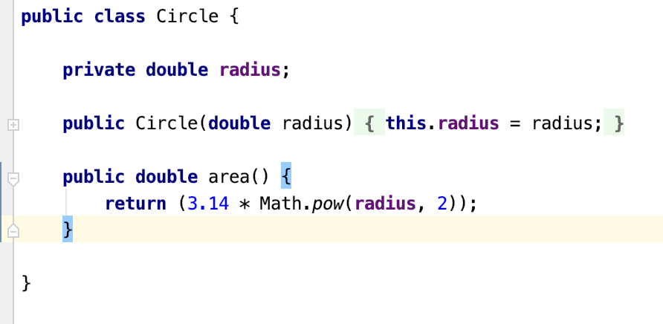
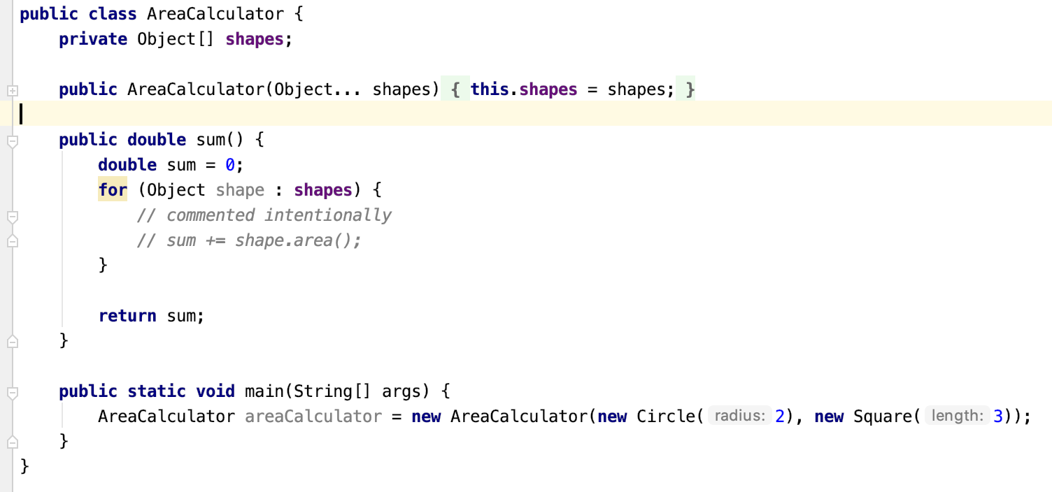
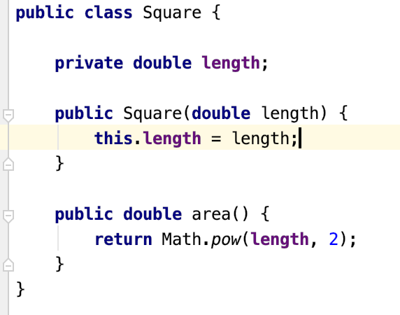
Open-Closed Principle
Objects or entities should be open for extension, but closed for modification.
Notes:
This simply means that a class should be easily extendable without modifying the class itself.
Let's take a look at the AreaCalculator class, especially it's sum method.
Problem
If we wanted the sum method to be able to sum the areas of more shapes, we would have to add more if/else blocks and that goes against the Open-closed principle.
Solution
A way we can make this sum method better is to remove the logic to calculate the area of each shape out of the sum method and attach it to the shape's class.
New Problem
now another problem arises, how do we know that the object passed into the AreaCalculator is actually a shape or if the shape has a method named area?

Slide 6
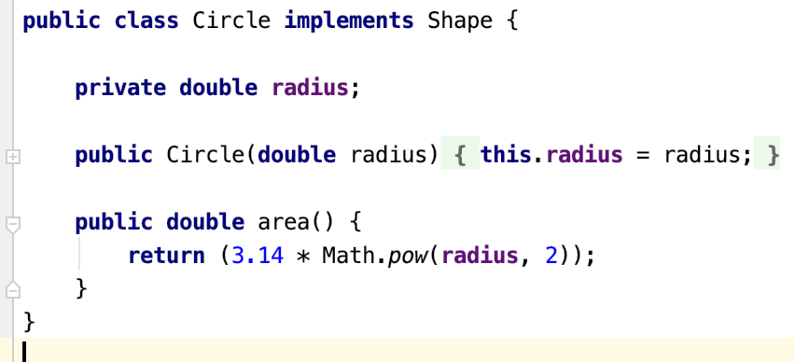
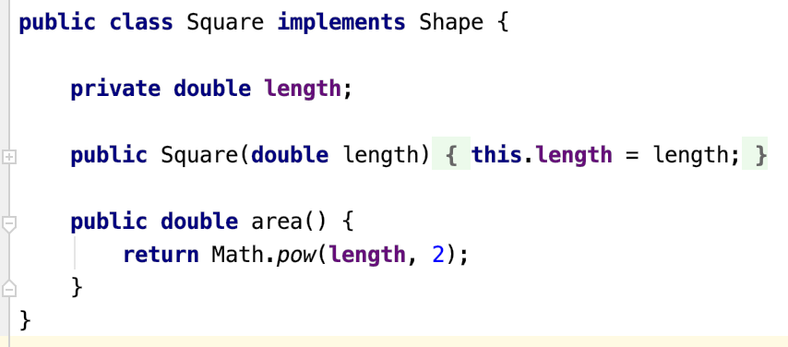
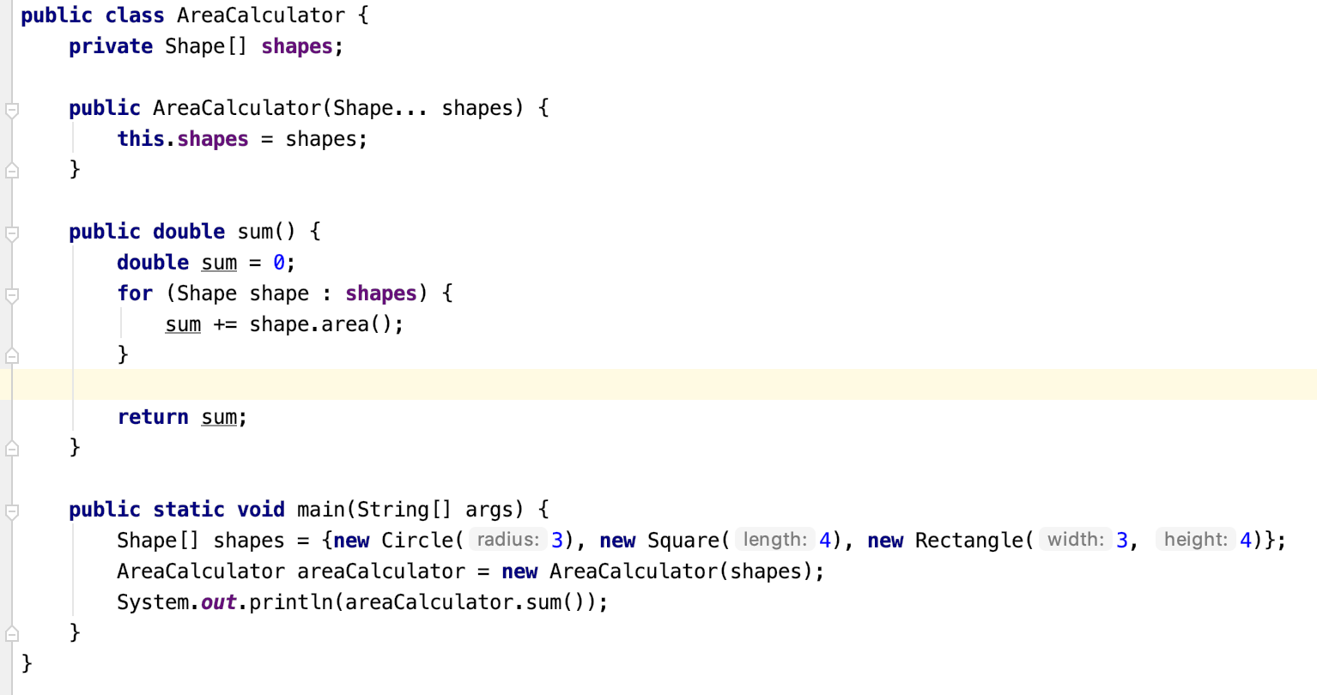
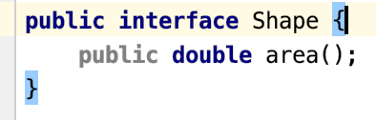
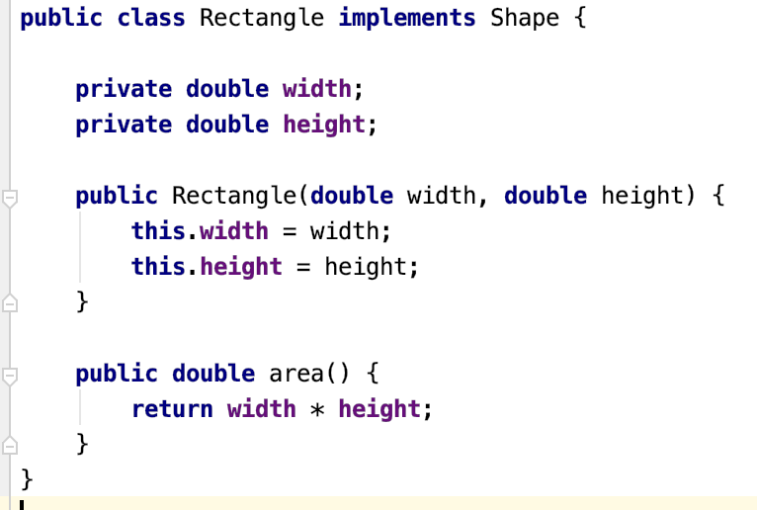
Open-Closed Principle
Notes:
This simply means that a class should be easily extendable without modifying the class itself.
Let's take a look at the AreaCalculator class, especially it's sum method.
Problem
If we wanted the sum method to be able to sum the areas of more shapes, we would have to add more if/else blocks and that goes against the Open-closed principle.
Solution
A way we can make this sum method better is to remove the logic to calculate the area of each shape out of the sum method and attach it to the shape's class.
New Problem
now another problem arises, how do we know that the object passed into the AreaCalculator is actually a shape or if the shape has a method named area?

Slide 7
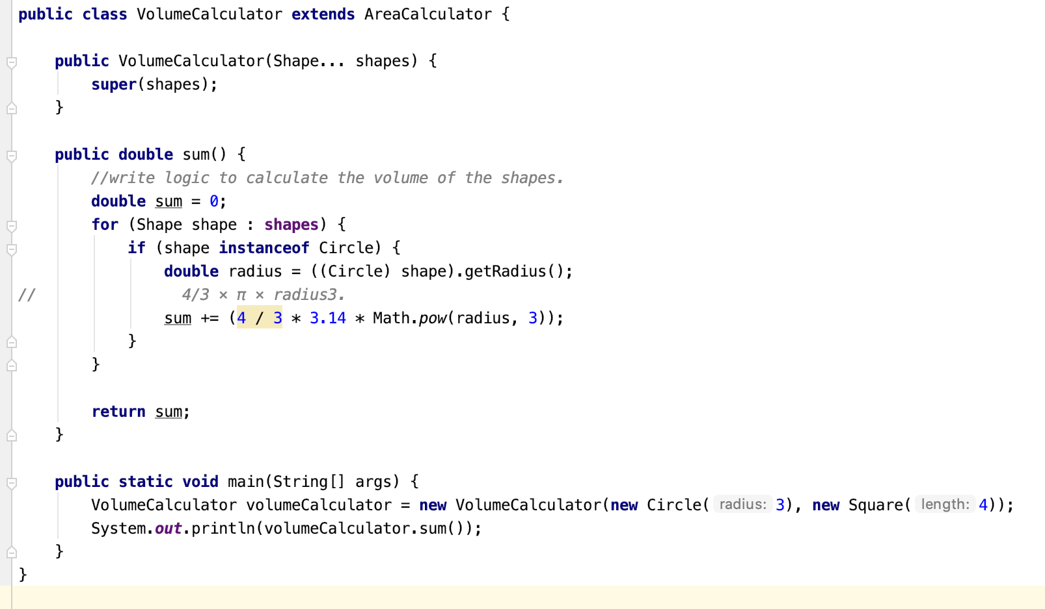
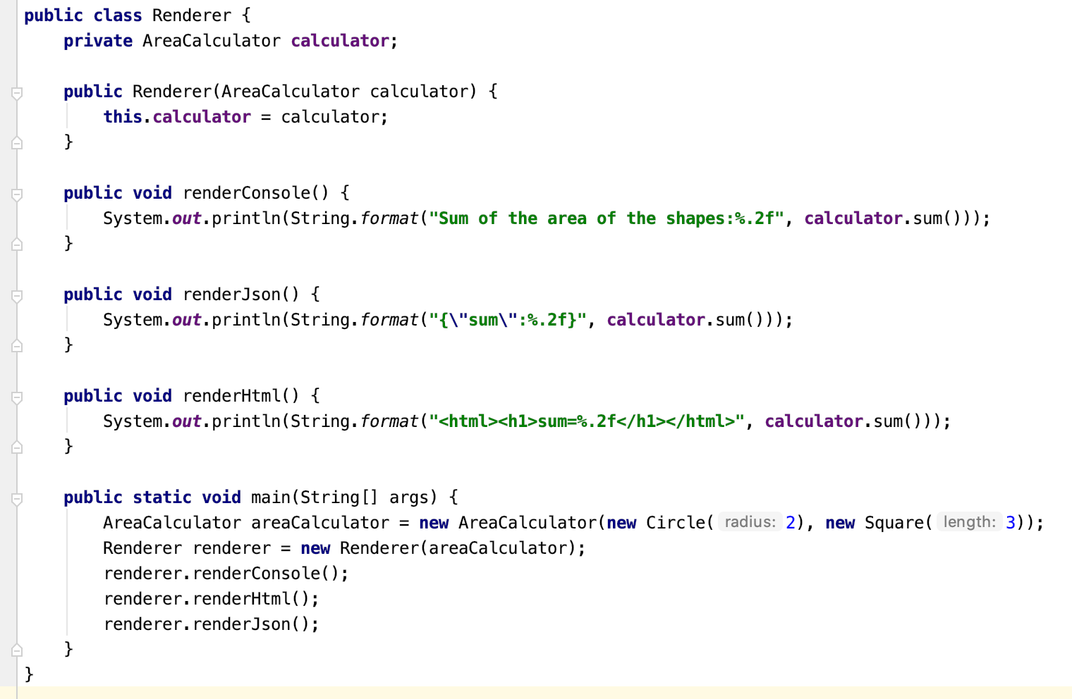
Liskov substitution principle
Let q(x) be a property provable about objects of x of type T. Then q(y) should be provable for objects y of type S where S is a subtype of T.
Notes:
Means that every subclass/derived class should be substitutable for their base/parent class.

Slide 8
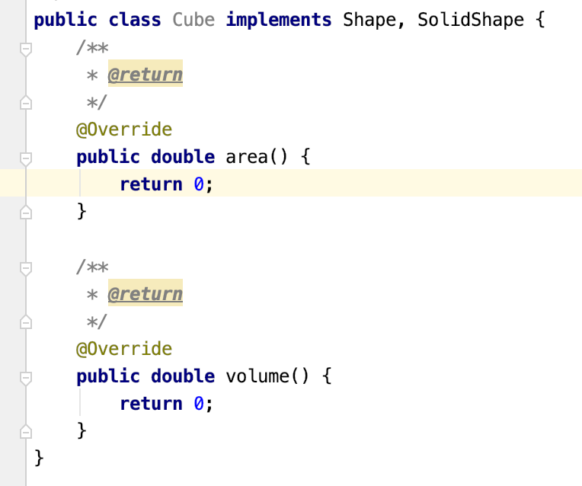
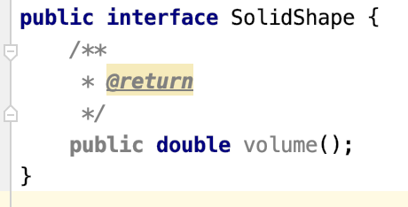
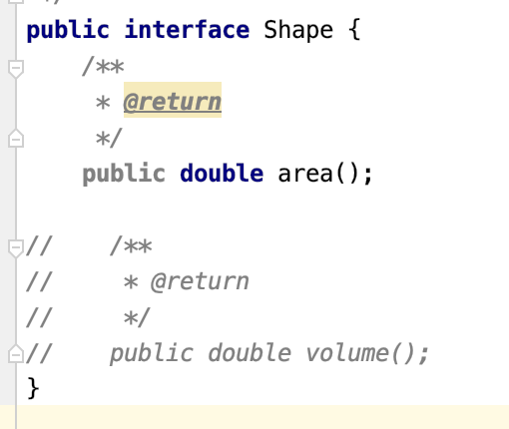
Interface segregation principle
A client should never be forced to implement an interface that it doesn't use or clients shouldn't be forced to depend on methods they do not use.
Notes:
add another contract to the Shape interface (add volume method in it).
Problem
Any shape now must implement the volume method, but we know that squares are flat shapes and that they do not have volumes, so this interface would force the Square class to implement a volume method that it has no use of.
Solution
create another interface called SolidShape Interface that has the volume contract and solid shapes like cubes etc. can implement this interface:

Slide 9
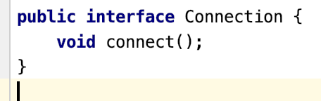
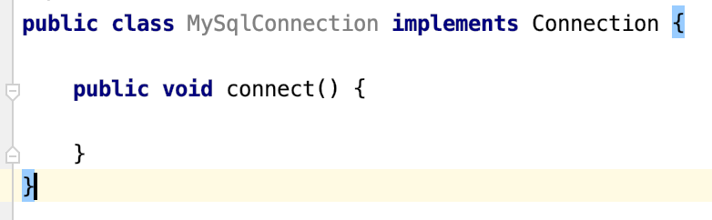
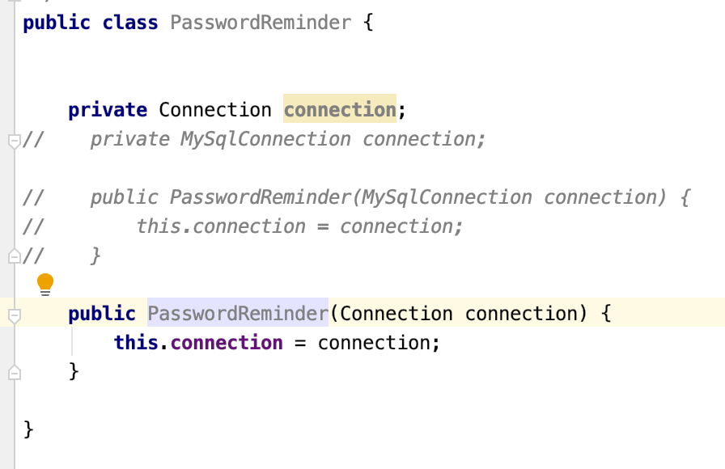
Dependency Inversion principle
Entities must depend on abstractions not on concretions. It states that the high level module must not depend on the low level module, but they should depend on abstractions.
Notes:
Later if you were to change the database engine, you would also have to edit the PasswordReminder class and thus violates Open-close principle.

